Slide 1
Lighting source setup
Haibin Zhu | 2021-01-04

Slide 2
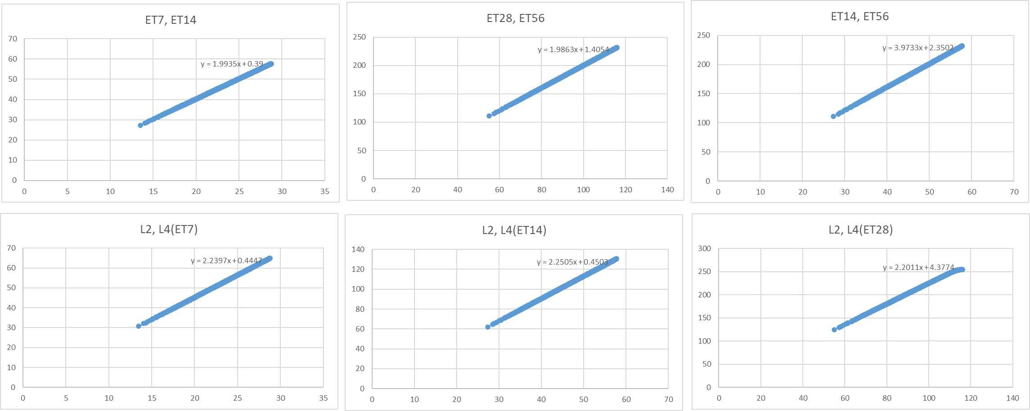
Greyscale changes correlate well
As the changes for each region are correlated, so multi-acq won’t benefit telling the lighting source position.

Slide 3
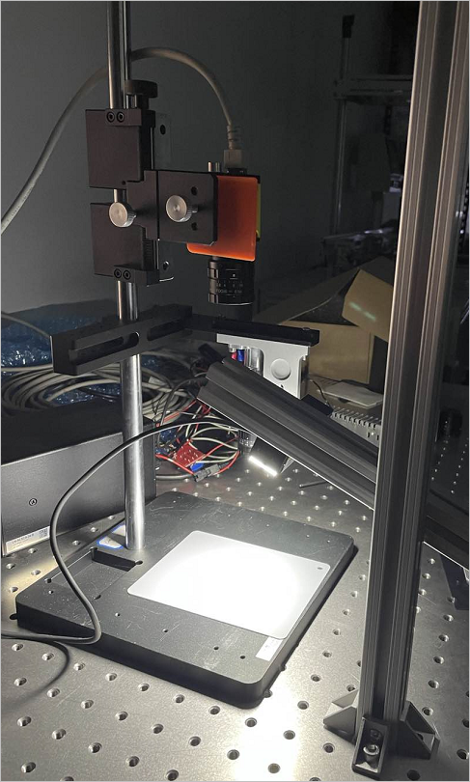
Precondition is not established
Precondition: Increase lighting power make the distribution more centralized. The test result shows that the intensity change by a same percentage.

Slide 4
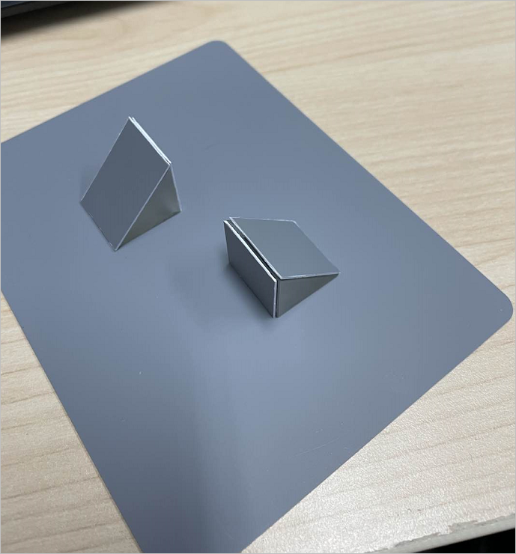
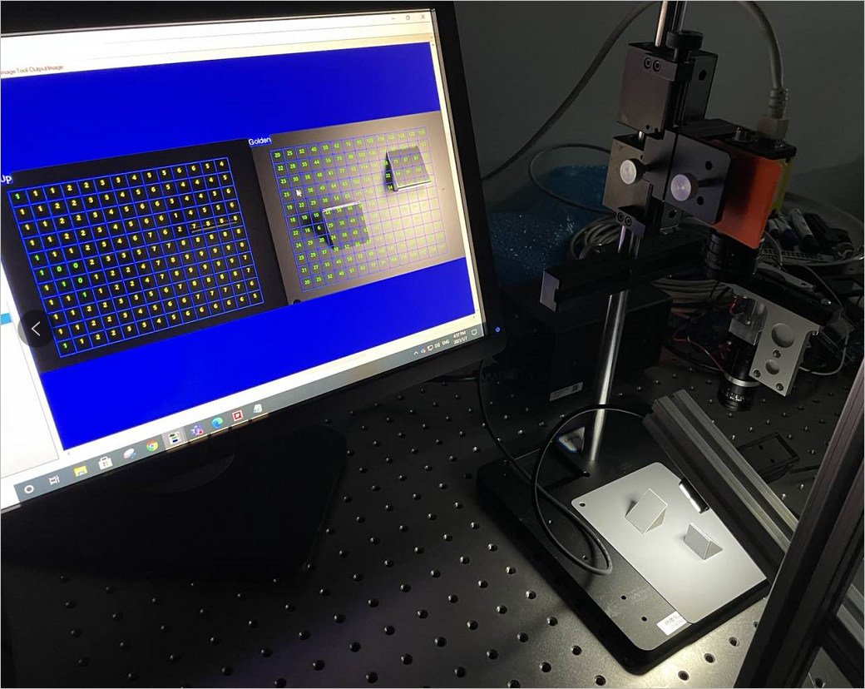
3D grey board setup

Slide 5
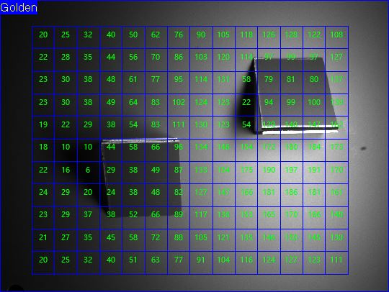
3D grey board setup
Absolute delta can‘t tell the height or intensity param, should use the ratio (bring up to golden)
To use the regions rected in red for direction advice.
Use the regions rected in green for overall intensity setting.

Slide 6
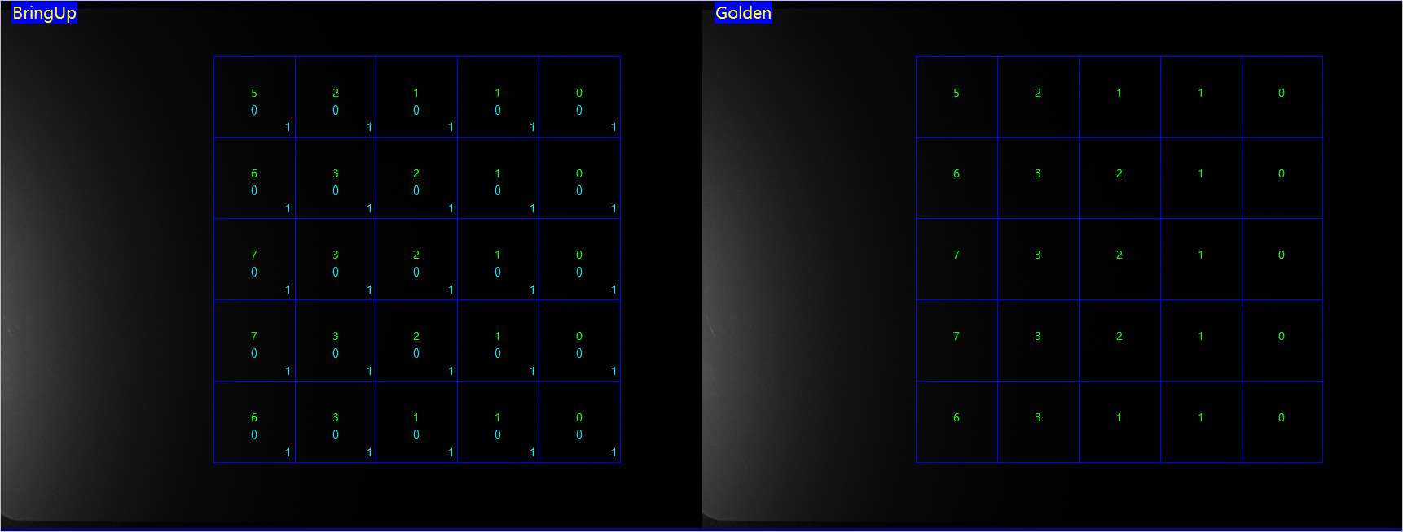
Shift test with flat grey board
GreyLevel
(Delta)
Ratio
Golden image

Slide 7
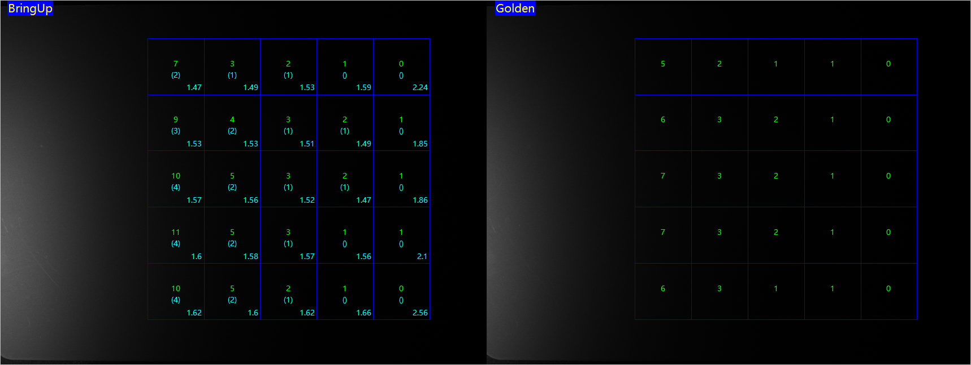
Shift test with flat grey board
GreyLevel
(Delta)
Ratio
Bring up image 1

Slide 8
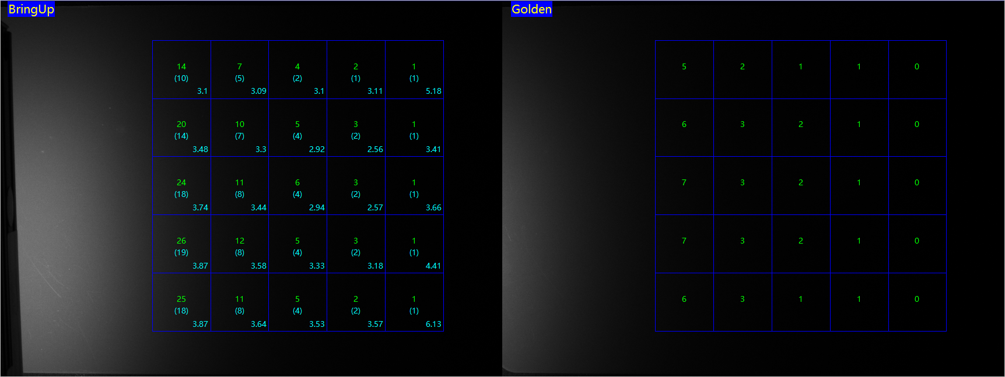
Shift test with flat grey board
GreyLevel
(Delta)
Ratio
Bring up image 2

Slide 9
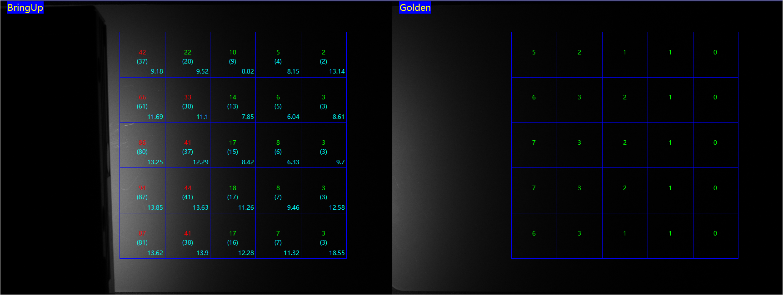
Shift test with flat grey board
GreyLevel
(Delta)
Ratio
Bring up image 3

Slide 10
Shift test with flat grey board
1. Ratio varies too big, and linear trendancy on the delta grey level, then need to shift the lighting

Slide 11
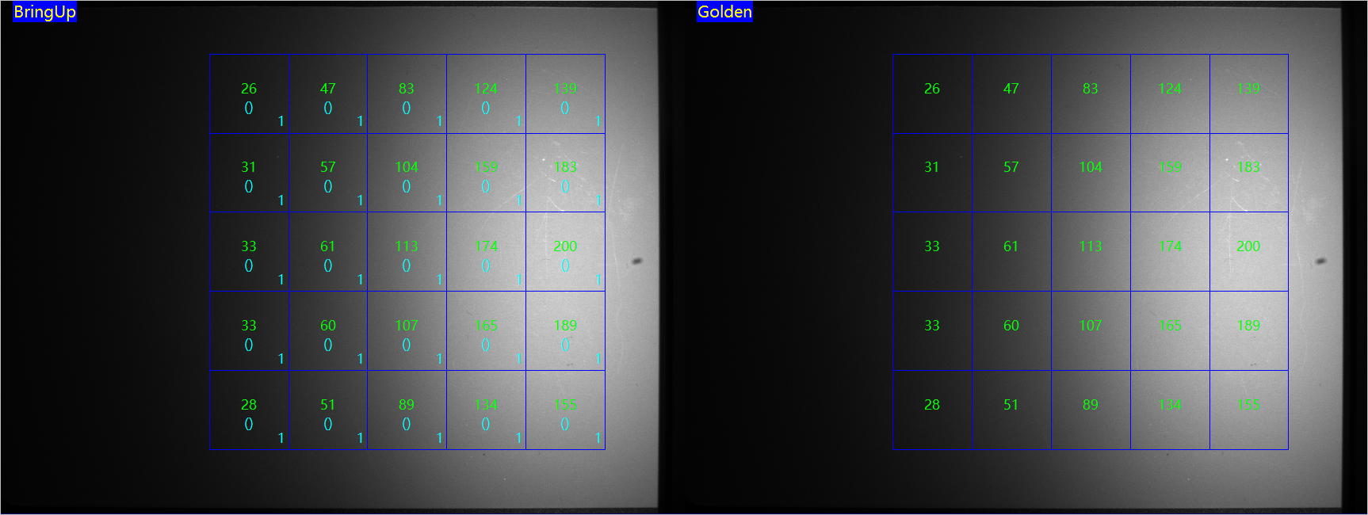
Height test with flat grey board
GreyLevel
(Delta)
Ratio
Golden image

Slide 12
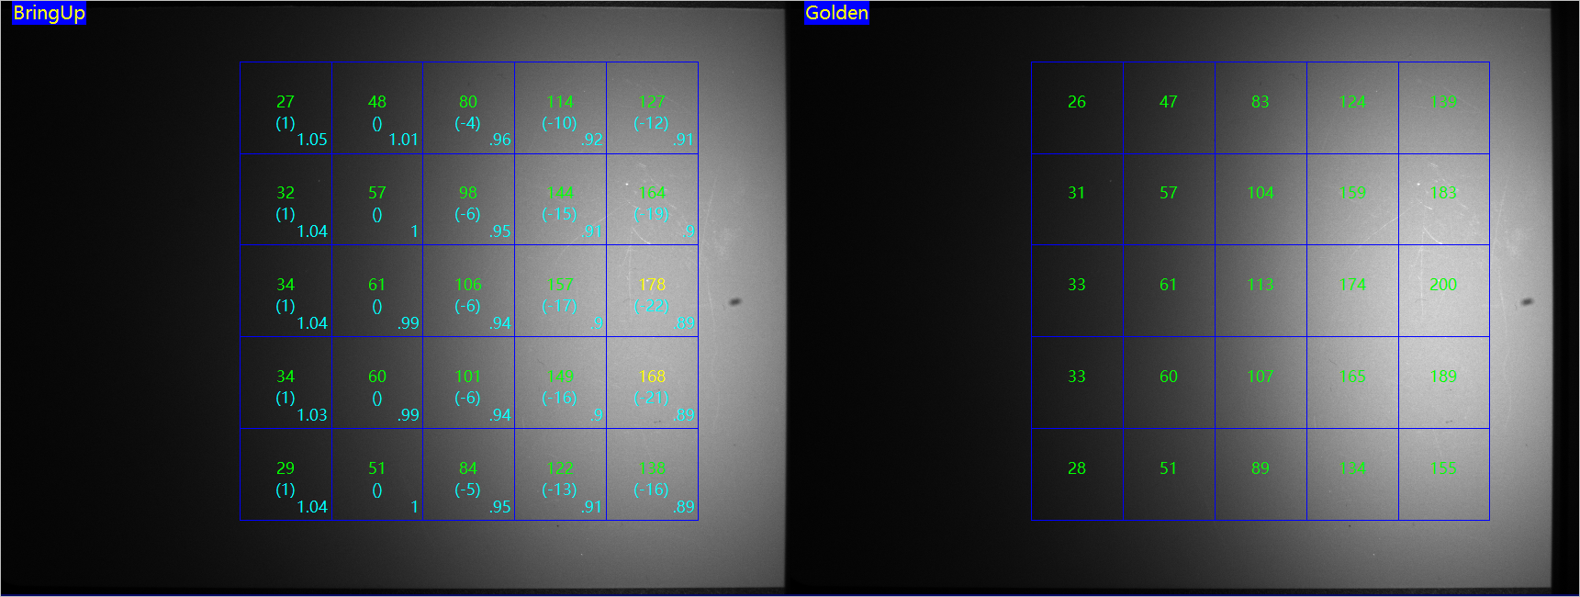
Height test with flat grey board
GreyLevel
(Delta)
Ratio
Bring up image 2

Slide 13
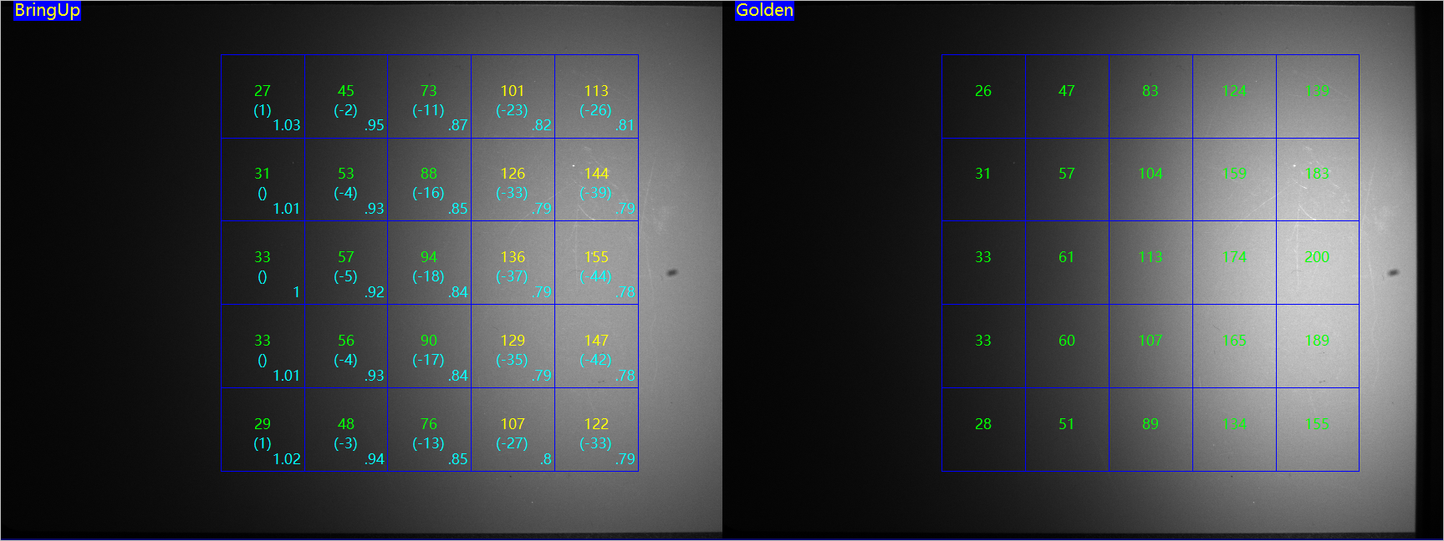
Height test with flat grey board
GreyLevel
(Delta)
Ratio
Bring up image 3

Slide 14
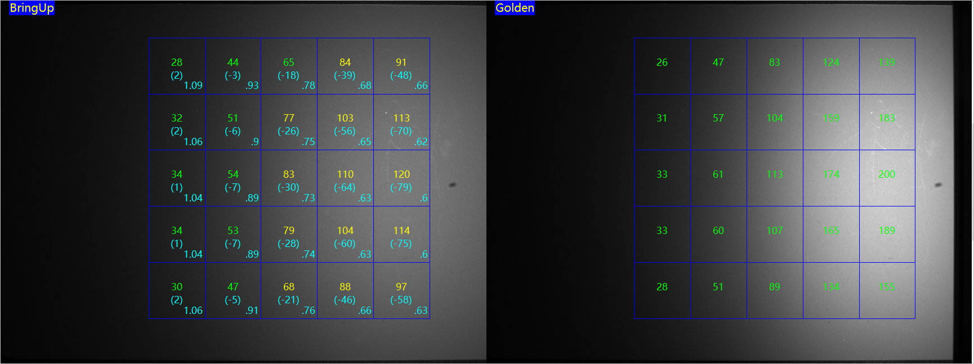
Height test with flat grey board
GreyLevel
(Delta)
Ratio
Bring up image 4

Slide 15
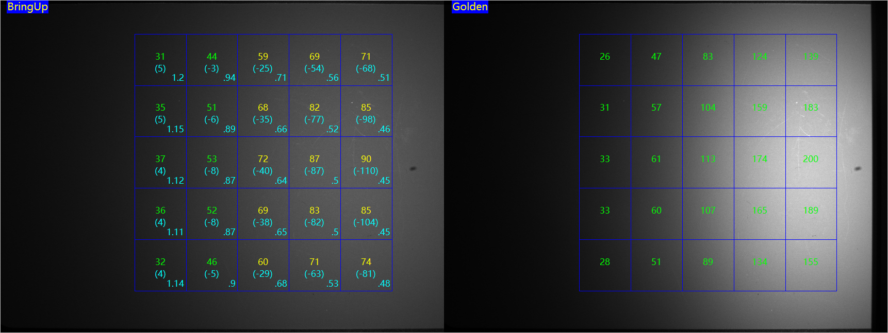
Height test with flat grey board
GreyLevel
(Delta)
Ratio
Bring up image 5

Slide 16
Height test with flat grey board
Ratio varies too much, need adjust height.
If the range is small, maybe the intensity adjustment will also work.
New intensity = old intensity *(OldHeight)^2 / (NewHeight)^2;
GreyLevel
(Delta)
Ratio

Slide 17
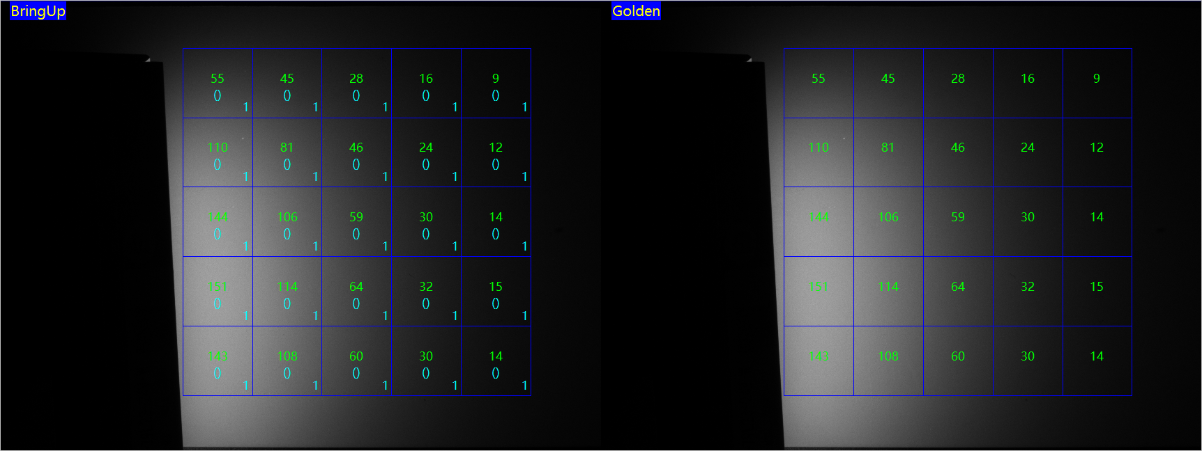
Angle test with flat grey board
GreyLevel
(Delta)
Ratio
Golden image

Slide 18
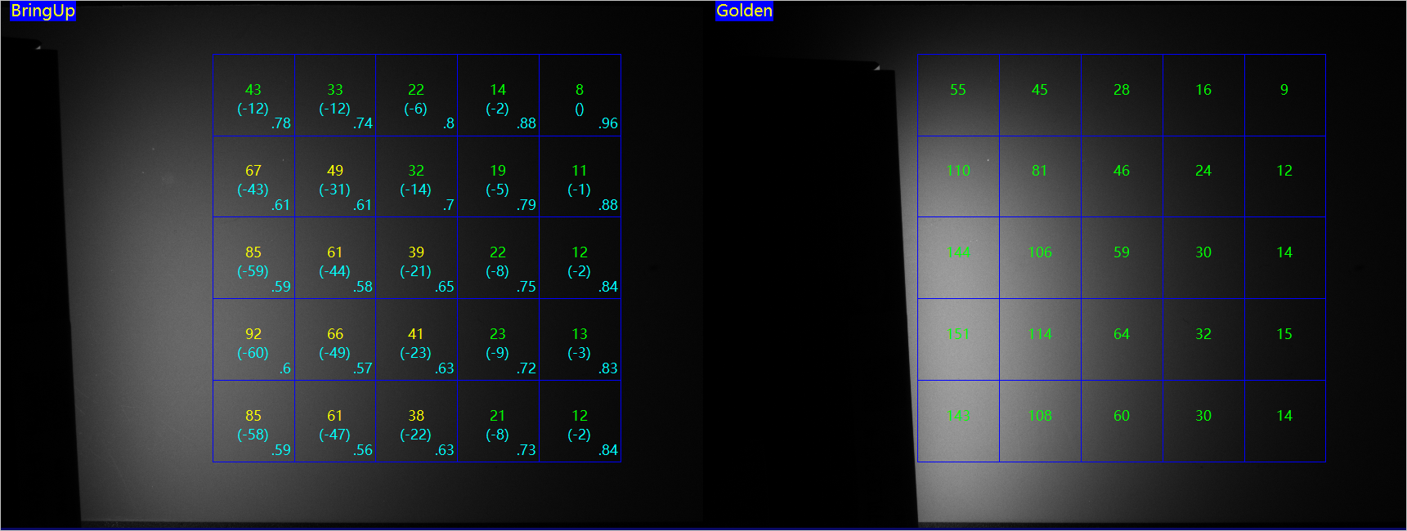
Angle test with flat grey board
GreyLevel
(Delta)
Ratio
Bring up image 1

Slide 19
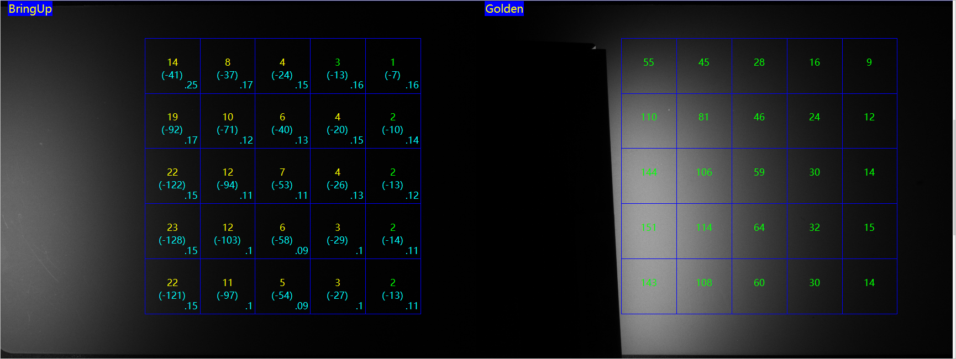
Angle test with flat grey board
GreyLevel
(Delta)
Ratio
Bring up image 2

Slide 20
Shift test with flat grey board (SearchMax)
Train the region within SearchMax, and locate the pattern in the bring-up images.
** Enable angle range will cost a lot of time.

Slide 21
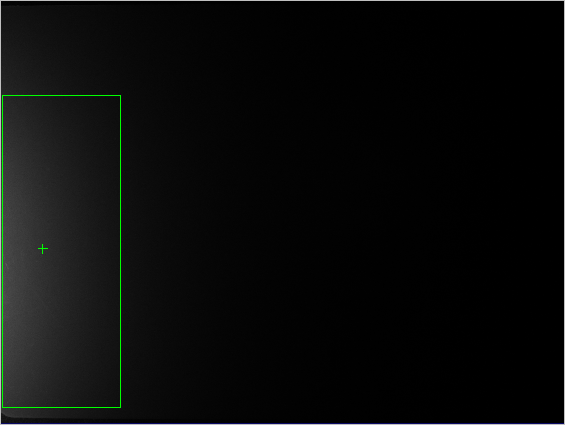
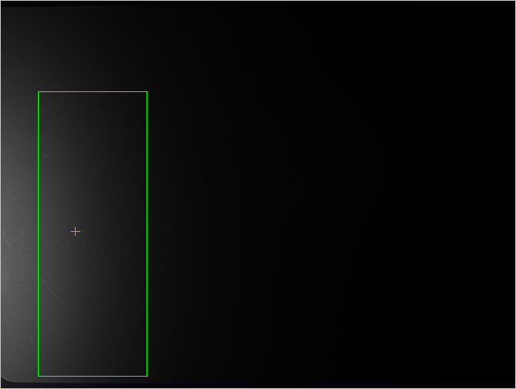
Shift test with flat grey board (SearchMax)
SearchMax runs fine in this situation.

Slide 22
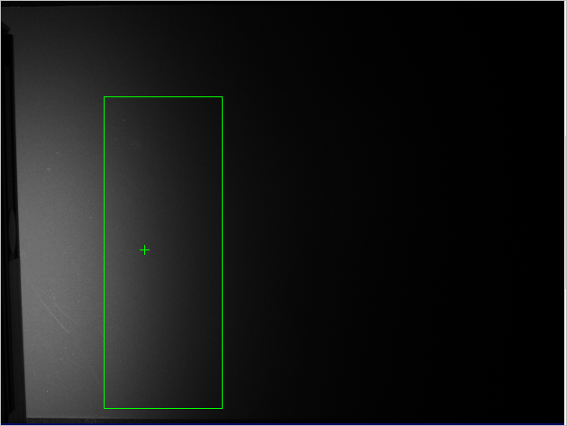
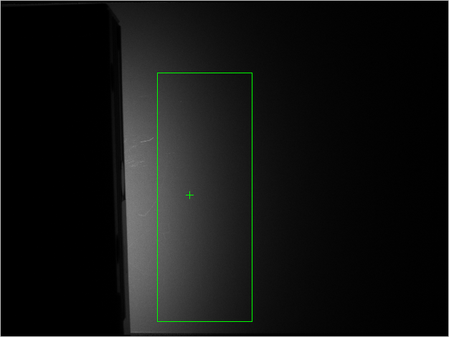
Shift test with flat grey board (SearchMax)
SearchMax runs fine in this situation.

Slide 23
Closing Slide – Thank You

